Slide 1


How to Trigger a Build from External Links in Jenkins
Learn how to easily trigger a Jenkins build from anywhere with just a few simple steps.
by Charanjit Singh

Slide 2
Introduction to Jenkins
What is Jenkins?
Why use Jenkins?
Who uses Jenkins?
Jenkins is an open source automation server that is used to automate parts of the software development process.
Jenkins offers a wide range of features that make the software development process easier, such as automatic testing and building of code.
Many software companies use Jenkins, including companies like Google, Netflix, and IBM.

Slide 3



Overview of Build Triggering Methods in Jenkins
Polling Build Triggers
Webhook Build Triggers
Manual Build Triggers
Periodically checks the source code repository for changes and triggers a build if changes are detected.
Automatically triggers a build when webhook events are received from external services, like GitHub.
Manually triggers a build from the Jenkins user interface or terminal using the build trigger button or command.

Slide 4
Using Remote Access API to Trigger Jenkins Build from External Links
Step 2: Generate a Jenkins API Token
This token will be used to authenticate all external requests.
1
2
3
Step 1: Install Jenkins Remote API Plugin
Step 3: Trigger Build with HTTP Request
This will enable external HTTP requests to be made to Jenkins from other applications or scripts.
Send an HTTP request to the Jenkins remote access API endpoint to trigger the build.

Slide 5
Configuring Jenkins Security Settings for External Build Triggering
Enabled by Default
Manage Access Controls
Remote API and webhook triggering are enabled by default in Jenkins.
Use the Jenkins security settings to control who can trigger builds from external links and which build jobs are eligible.

Slide 6

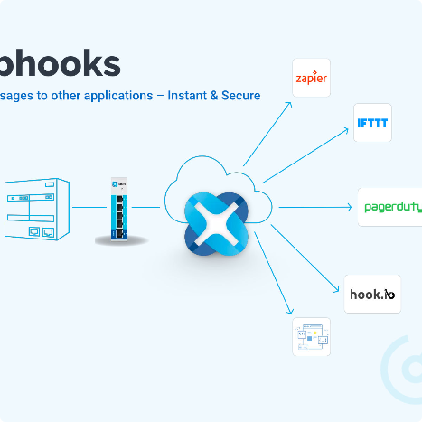
Examples of Triggering Jenkins Build from External Links Using cURL and Webhooks
cURL Example
Webhooks Example
Trigger a Jenkins build using a cURL command: curl -X POST JENKINS_URL/job/JOB_NAME/build --user USER:TOKEN
Automatically trigger a Jenkins build using GitHub webhooks when changes are merged into the master branch.

Slide 7

Best Practices for External Build Triggering in Jenkins
1
Authenticate all Requests
2
Keep Track of Triggers
Use the Jenkins build history to keep track of who is triggering builds and for what reason.
Always use authentication tokens to authenticate all requests that are sent to Jenkins.
3
Manage Access Controls
Only allow authorized people and services to trigger builds from external links.

Slide 8
Conclusion and Q&A Session
Conclusion
Q&A Session
External build triggering is a powerful tool that can help automate your software development process. Use it wisely and securely to reap its benefits.
Ask any questions you have about external build triggering in Jenkins and the best practices for using it.

